Slide 1
LLM, Find My Fund! Project Proposal
Hackathon Challenge – Intelligent Fund Matching using Small Language Models
TEAM - VICTORY VORTEX
VENUE - New HORIZON COLLEGE OF ENGINEERING

Slide 2


Our team
Surya
Sreejith
Moneesh
Manoj
Front-End Support and PowerPoints
Back-End Lead and UI/UX Design
Front-End and Support Role
Front-End and
Creative Dept

Slide 3
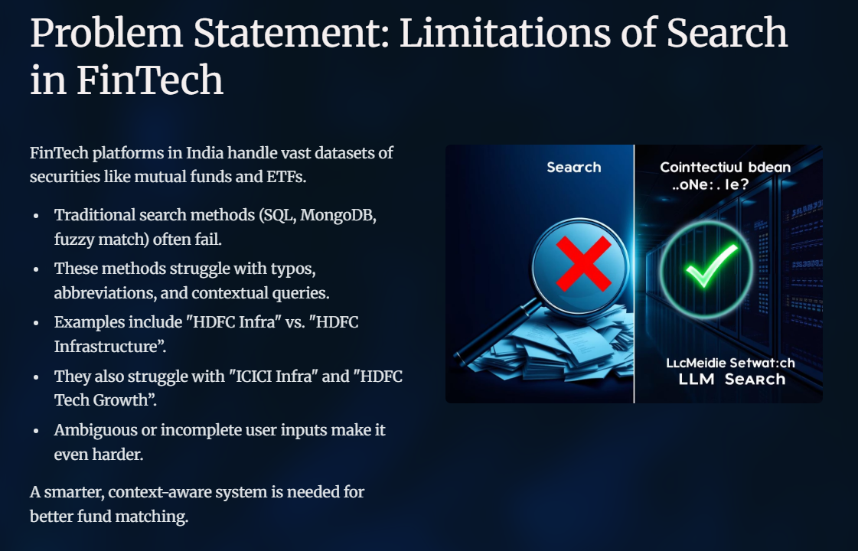
Problem Statement

Slide 4
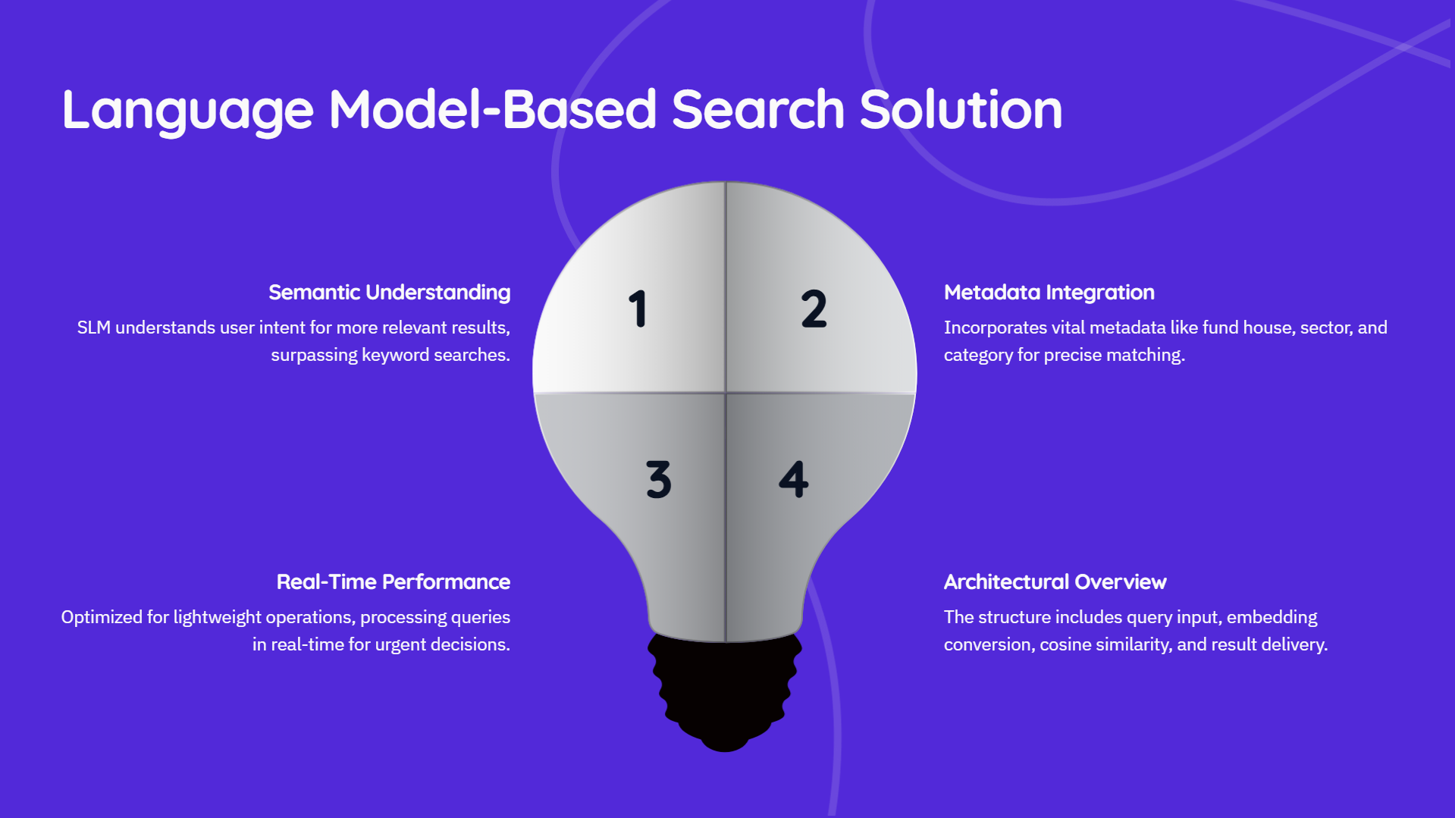
Contents of this template

Slide 5
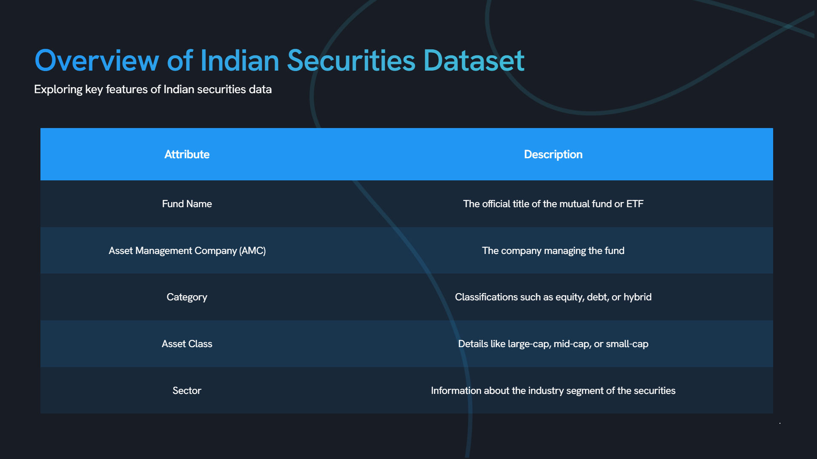

Slide 6
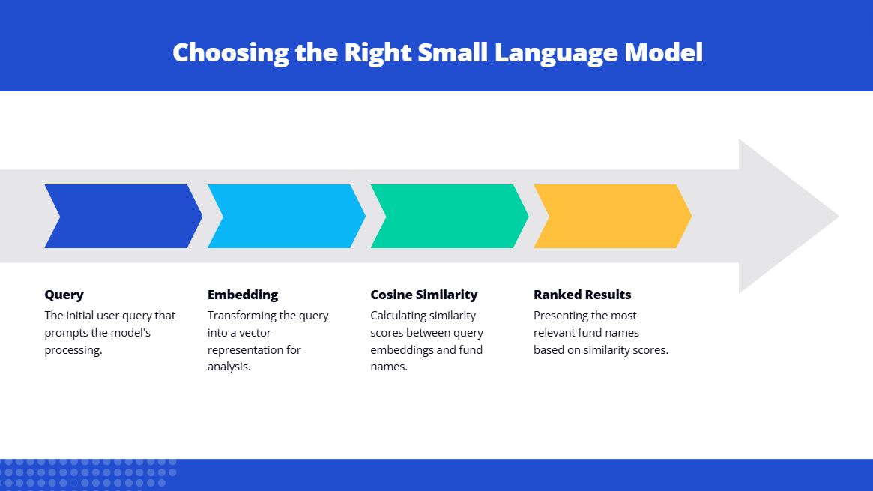
Table of contents
01
02
03
04
05
06
the project
requirements
project goals
You can describe the topic of the section here
You can describe the topic of the section here
You can describe the topic of the section here
sneak peek
project stages
our team
You can describe the topic of the section here
You can describe the topic of the section here
You can describe the topic of the section here

Slide 7
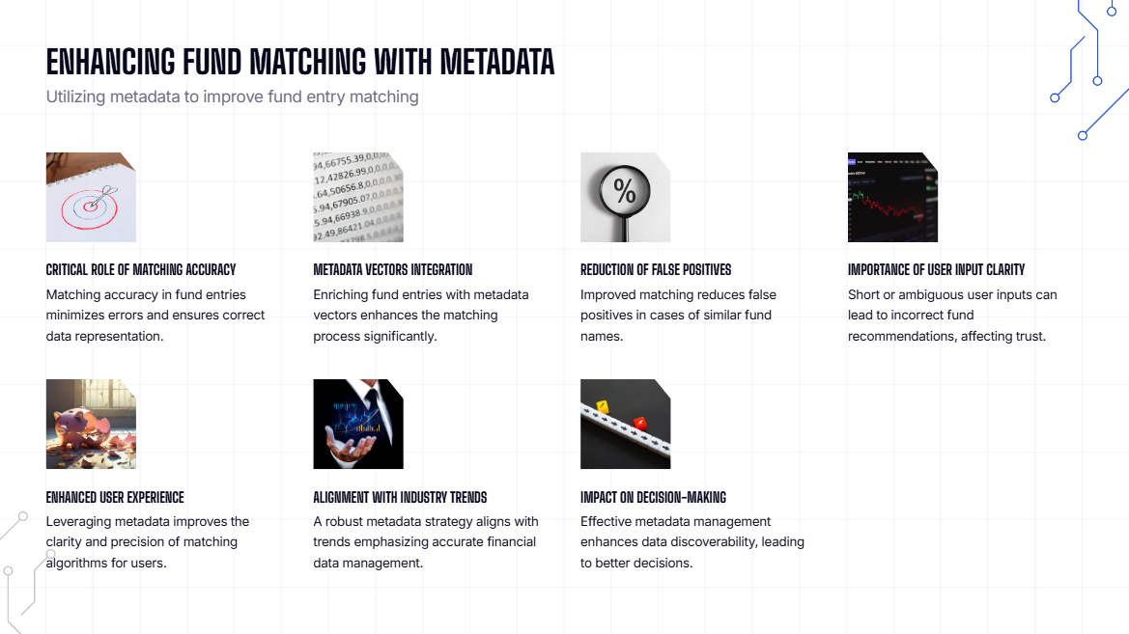

Our company
Mercury is the closest planet to the Sun and the smallest one in the Solar System—it’s only a bit larger than the Moon. The planet’s name has nothing to do with the liquid metal, since Mercury was named after the Roman messenger god

Slide 8
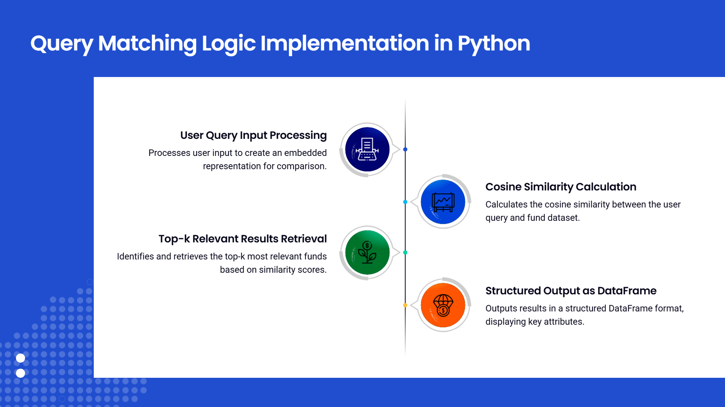
01
THE PROJECT
You can enter a subtitle here if you need it

Slide 9
About the project
Example Predictions in Finance
Analyzing HDFC Fund Holdings with Python
Real-World Queries & Results
🧠 Input: “funds with HDFC holdings” ✅ Output: "HDFC Equity Fund", etc. with high similarity score
Mercury is the closest planet to the Sun and the smallest one in the Solar System—it’s only a bit larger than the Moon. The planet’s name has nothing to do with the liquid metal, since Mercury was named after the Roman messenger god
📌 Code:
print(results[['schemeName', 'amcName', 'category', 'similarity']])

Slide 10
Metadata-Aware Intent Matching
Extracting User Intents from Query
Custom function to extract keywords like:
“infra”, “tax saving”, “large cap”, “high return”
Maps to metadata filters
📌 Code:
def extract_intents(query): ...

Slide 11
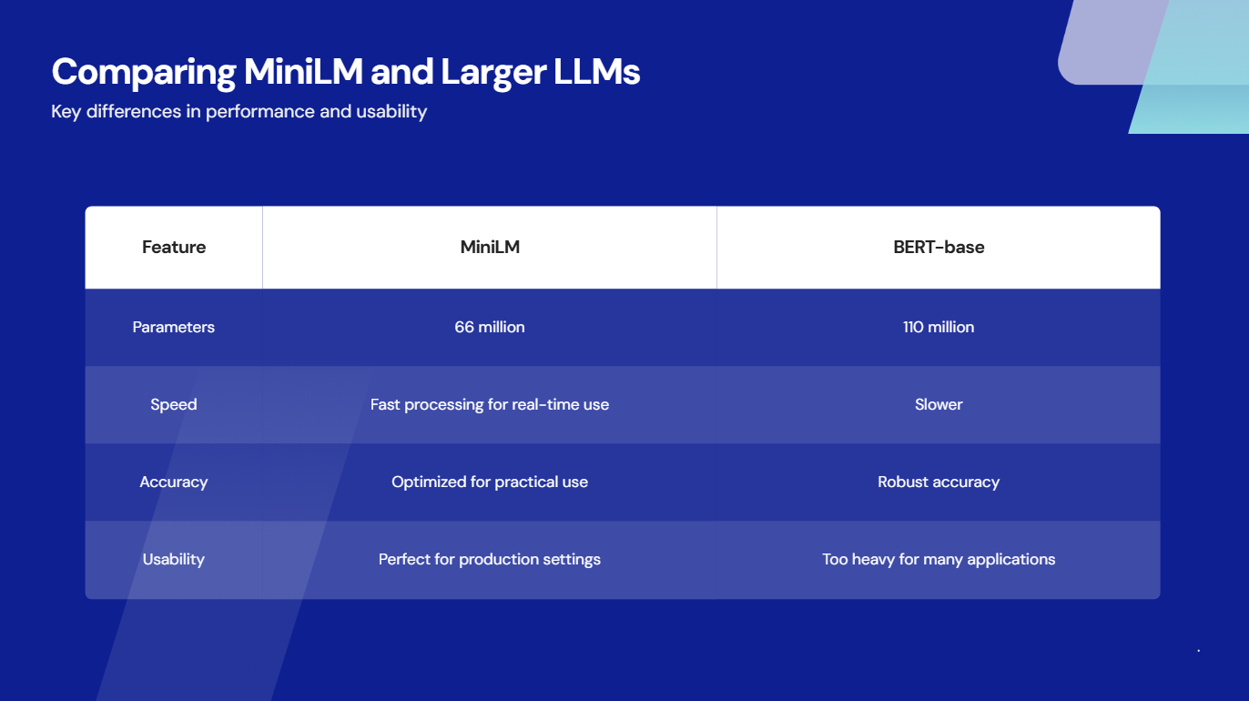

Slide 12
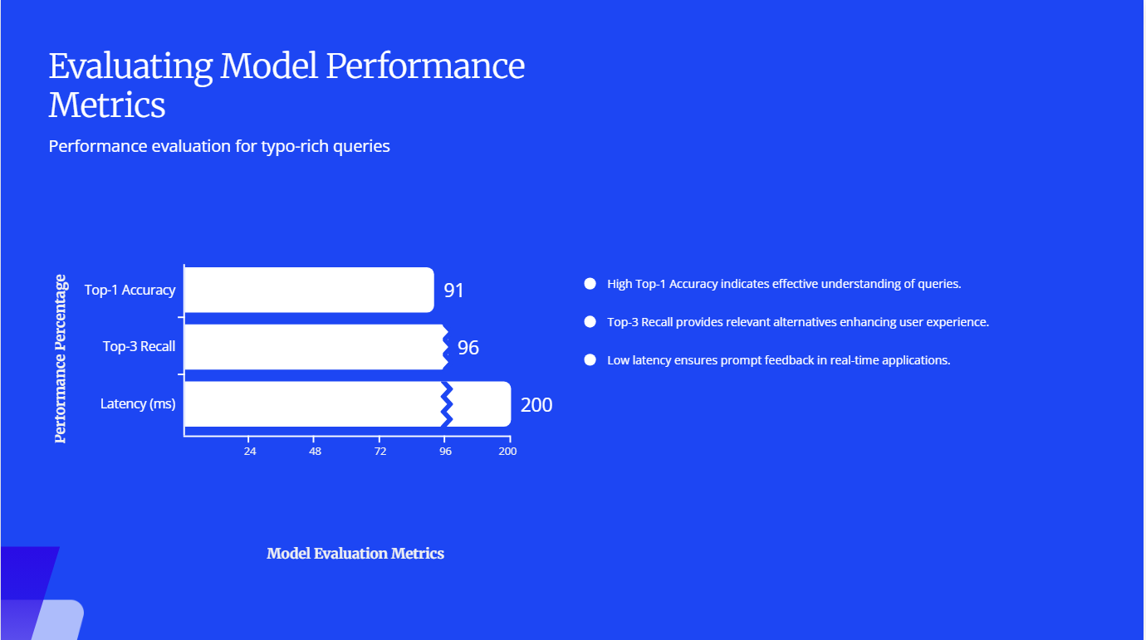

Slide 13
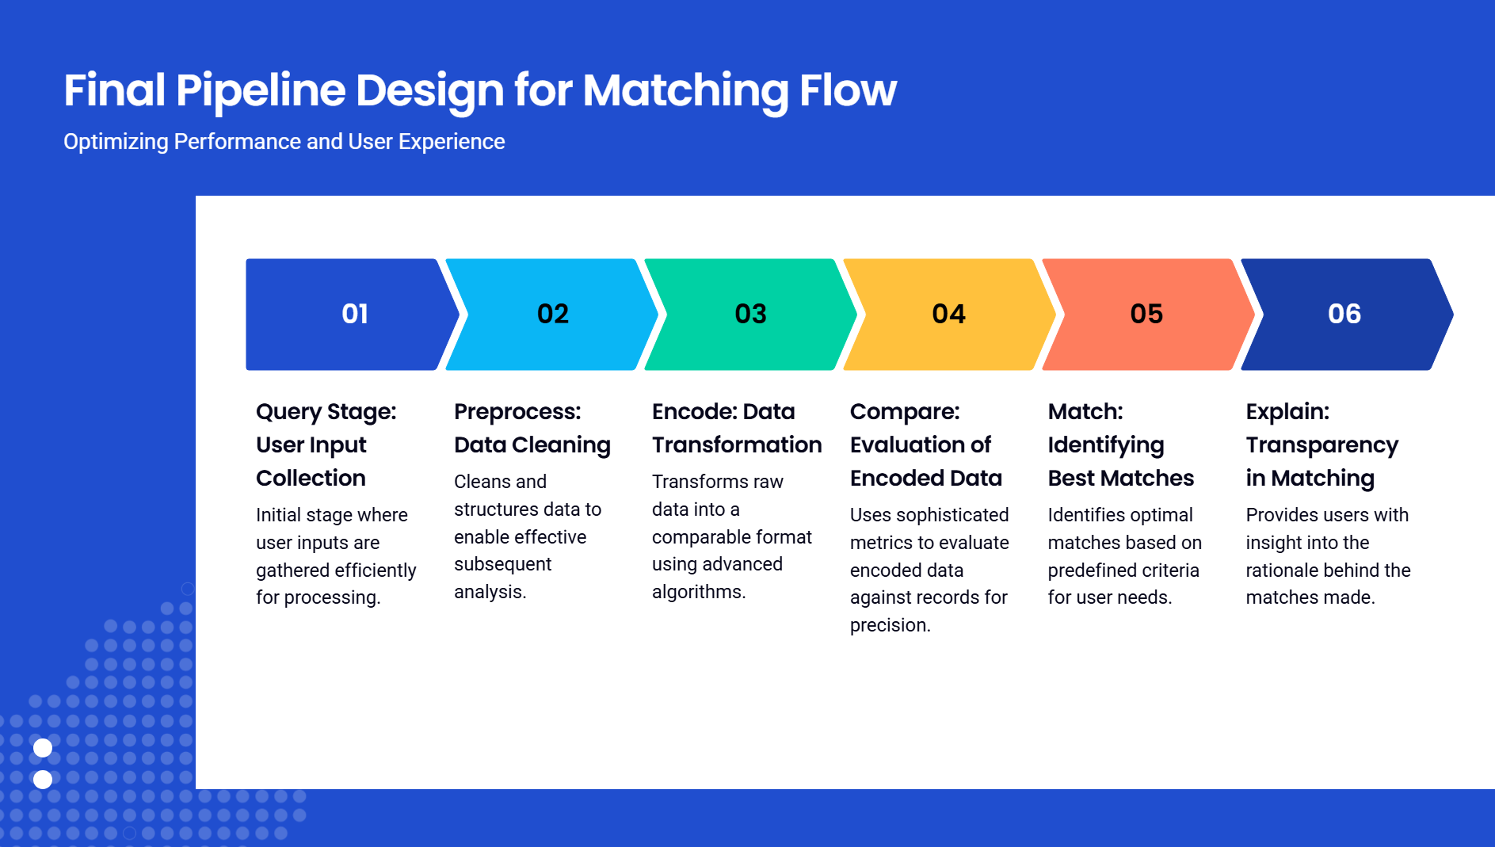

Slide 14
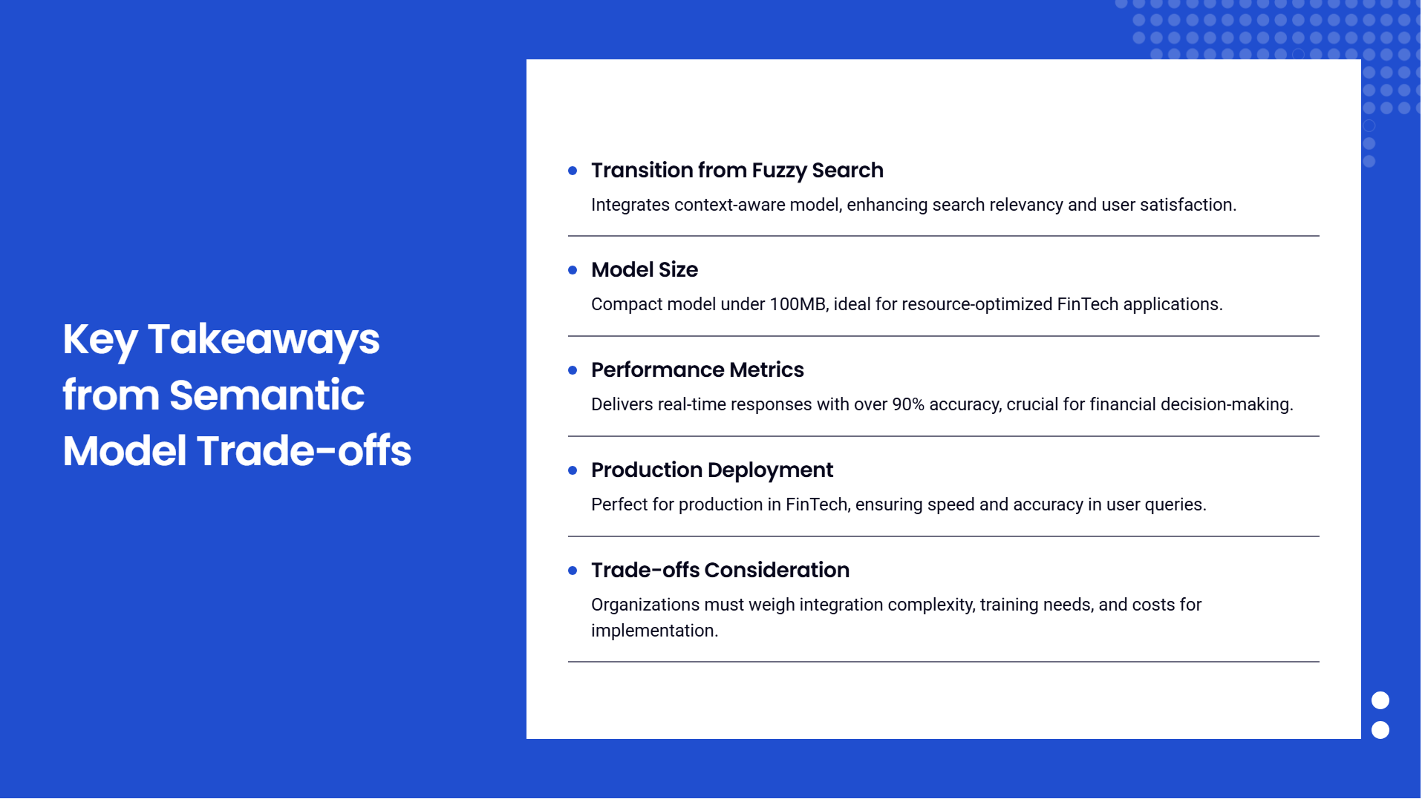

Slide 15
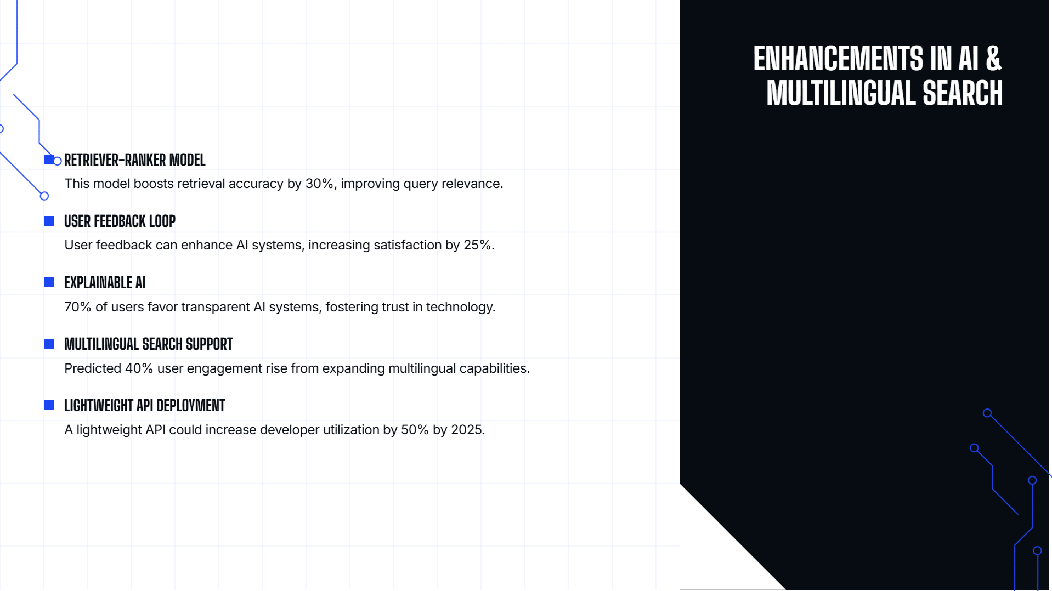

Slide 16
Thanks!
Do you have any questions?

